Slide 1
ILSpy
http://wiki.sharpdevelop.net/ILSpy.ashx

Slide 2
Objectives
Write programs with high-level lanaguages
.NET languages
Port the application to native languages:
Win32
UNIX
Android
Embedded systems
Improve the performance building the application with native code

Slide 3



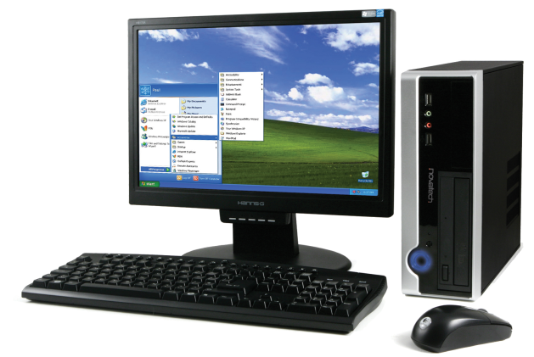
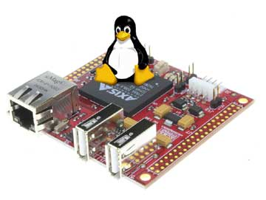
Objectives

Slide 4
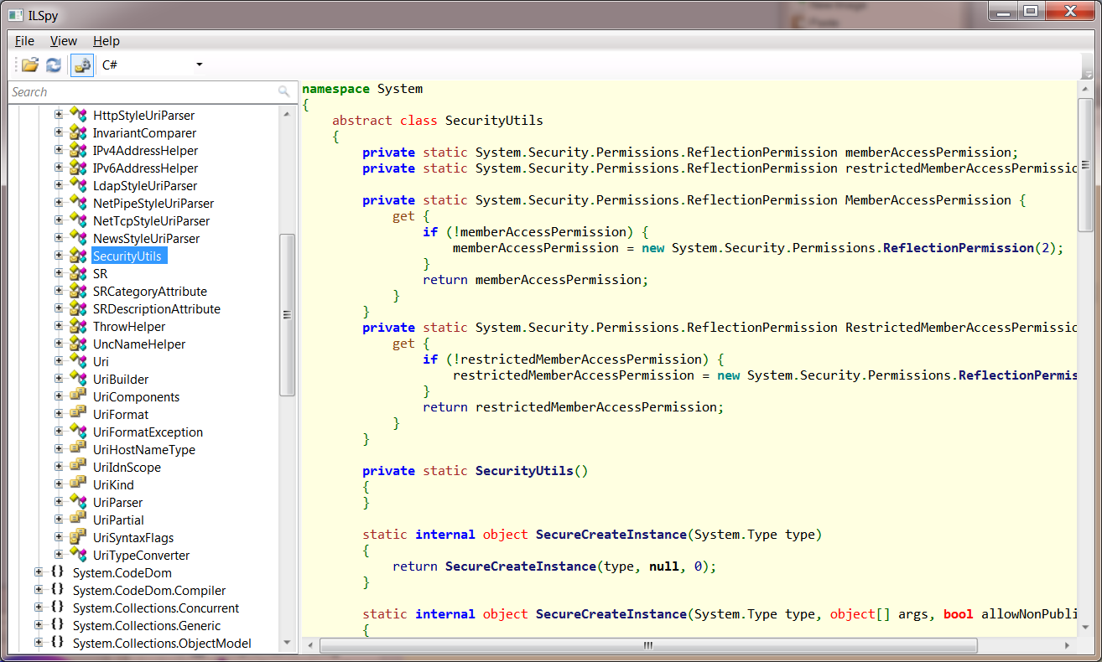
ILSpy
Assembly browser
Decompiler

Slide 5
General process
Initialization
Load assemblies
Print assemblies
When tree element clicked (or focused)
Generate AST Tree
Decompile

Slide 6
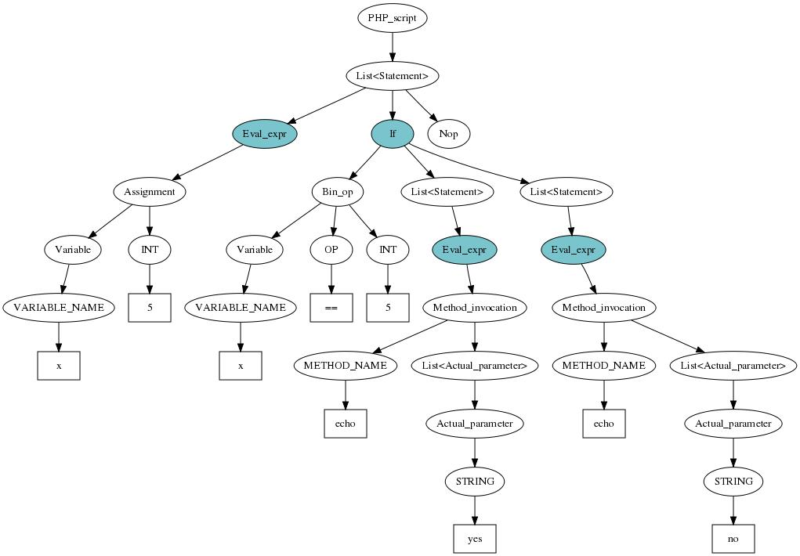
AST
Abstract Syntax Tree
Tree representation of source code
Related with the language

Slide 7
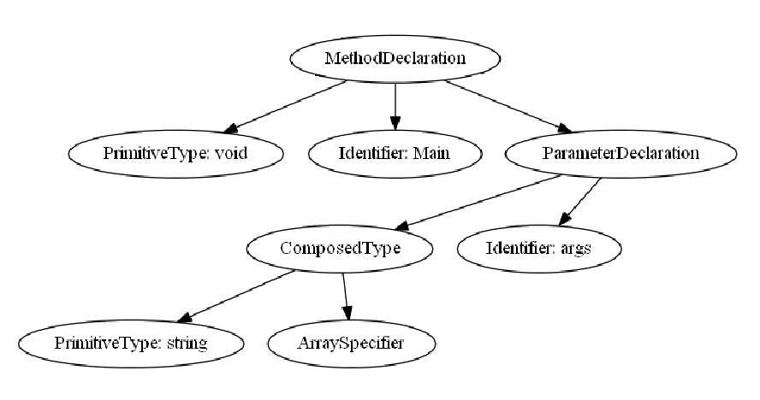
AST example Csharp

Slide 8
AST example PHP

Slide 9
General scheme
Load Assembly
CECIL Library
AST Builder
C# AST
C++ AST
C# Output Visitor
C++ Output Visitor
C# Language text output
C++ Language text output
C# to C++ Output Visitor

Slide 10
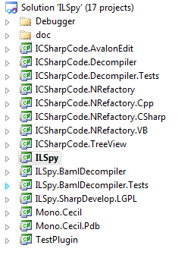
ILSpy source code
AST builder
AST managing
Tree view managing
Main program
Cecil library

Slide 11
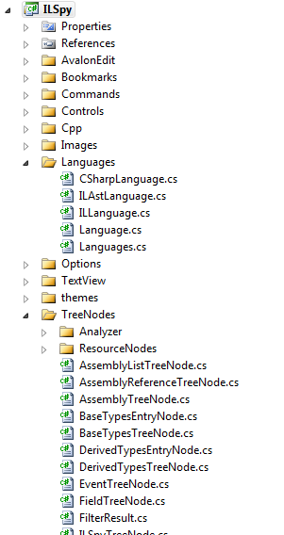
Important classes
AssemblyTreeNode (ILSpy Project)
ILSpyTreeNode
SharpTreeNode
Language (ILSpy Project)
C#
VB
IL
C++
IAstVisitor (ICSharpCode.NRefactory.<Language> Project)

Slide 12
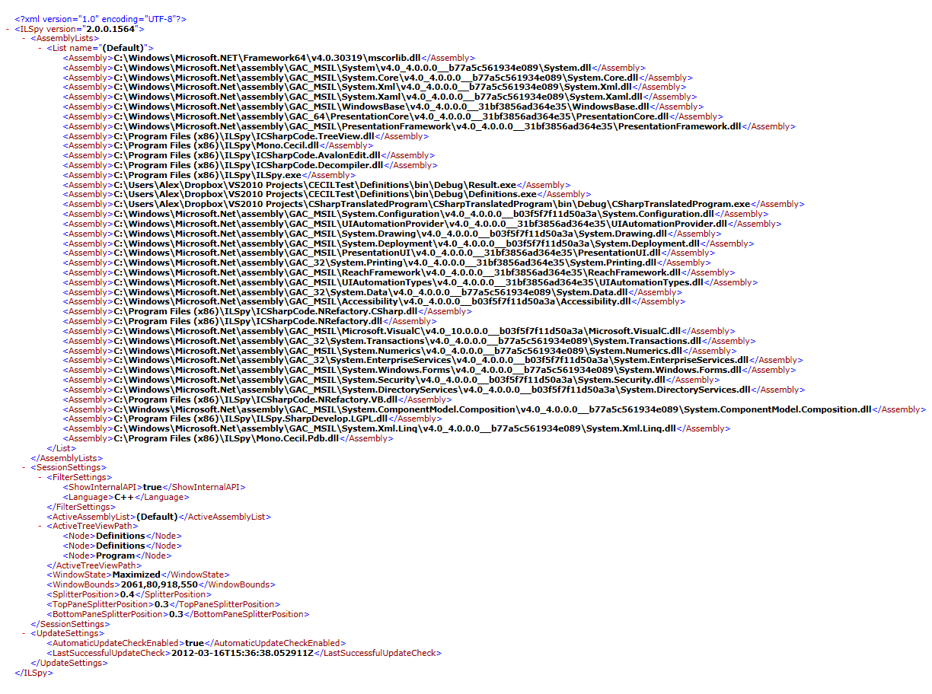
Loading Assemblies

Slide 13
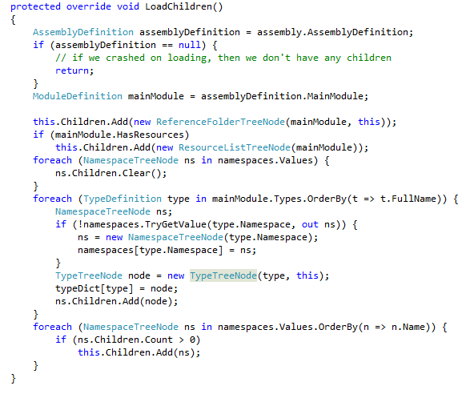
Loading with CECIL library

Slide 14
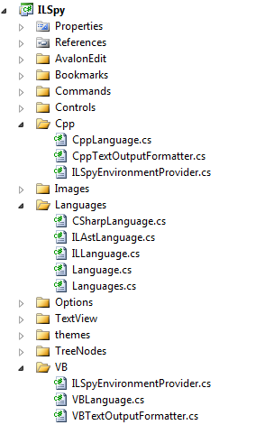
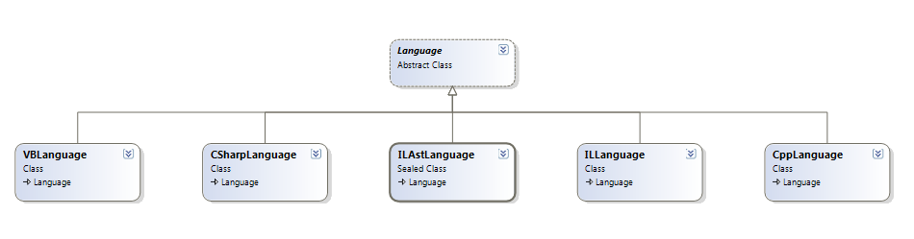
Languages
Interface
DecompileAssembly
DecompileMethod
DecompileProperty
DecompileField
DecompileEvent
DecompileType
DecompileNamespace

Slide 15
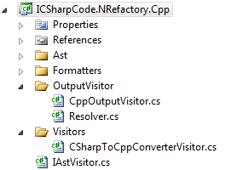
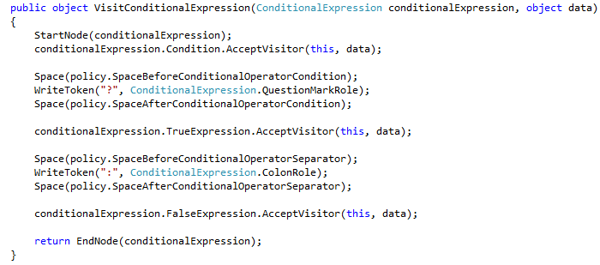
IAstVisitor
From AST to code
Depends on each language
Example:
A == 3 ? A++ : A = 3 ;

Slide 16
Important AST classes
AstNode
AstType : AstNode
PrimitiveType
SimpleType
…
Expression : AstNode
ThisReferenceExpression
LambdaExpression
…
Statement : AstNode
IfElseStatement
SwitchStatement
…

Slide 17
General scheme
Load Assembly
CECIL Library
AST Builder
C# AST
C# Output Visitor
C# Language text output
C# to C++ Output Visitor
C++ AST
C++ Output Visitor
C++ Language text output

Slide 18
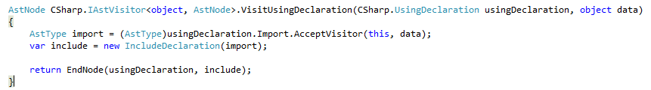
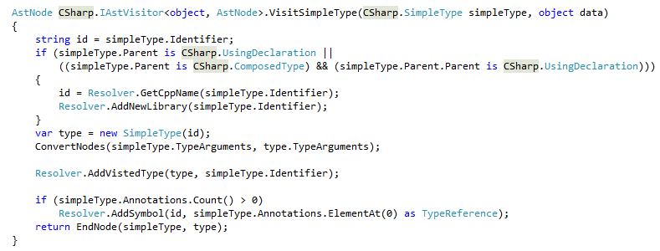
Translating code
Translator visitor
Changes in AST nodes

Slide 19
Example translation C# -> C++
void Main(string[] args){
}
void Main(String args[]){
}

Slide 20
Example AST transformation
Composed Identifier
void Main(string[] args){
}
void Main(string args[]){
}

Slide 21
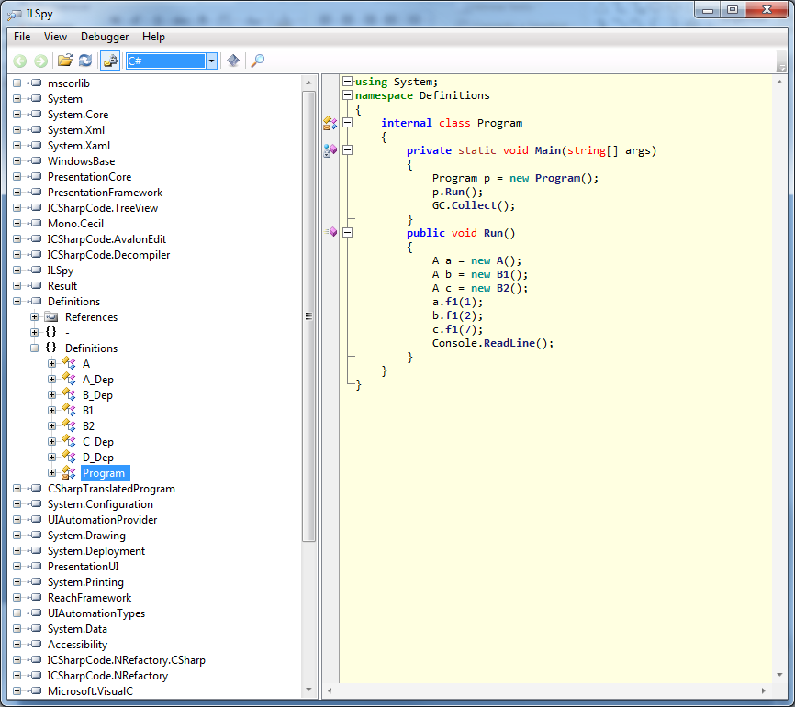
Result C#

Slide 22
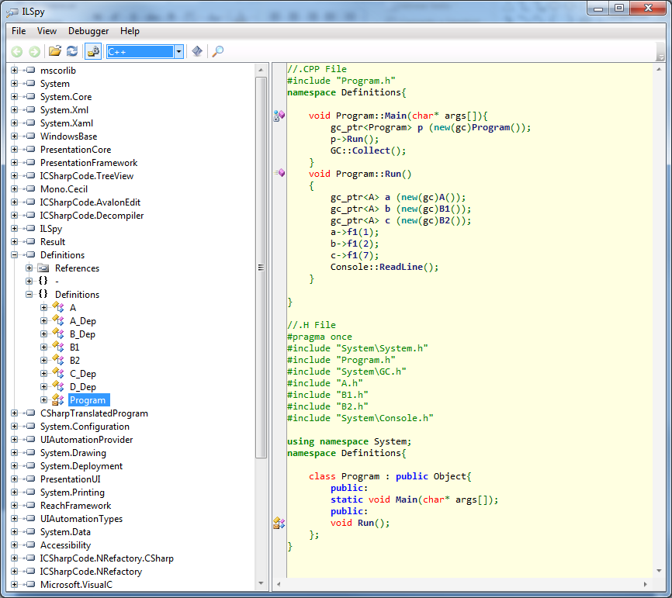
Result C++

Slide 23
Conclusions
A simple List implementation has been translated from .NET to:
Win32
UNIX
Android (native)
Implemented C++ API
Maintain C# syntax
Very simple memory management
Efficiency is not improved

Slide 24
Demo
Practical demo with a List application

